Slide 1
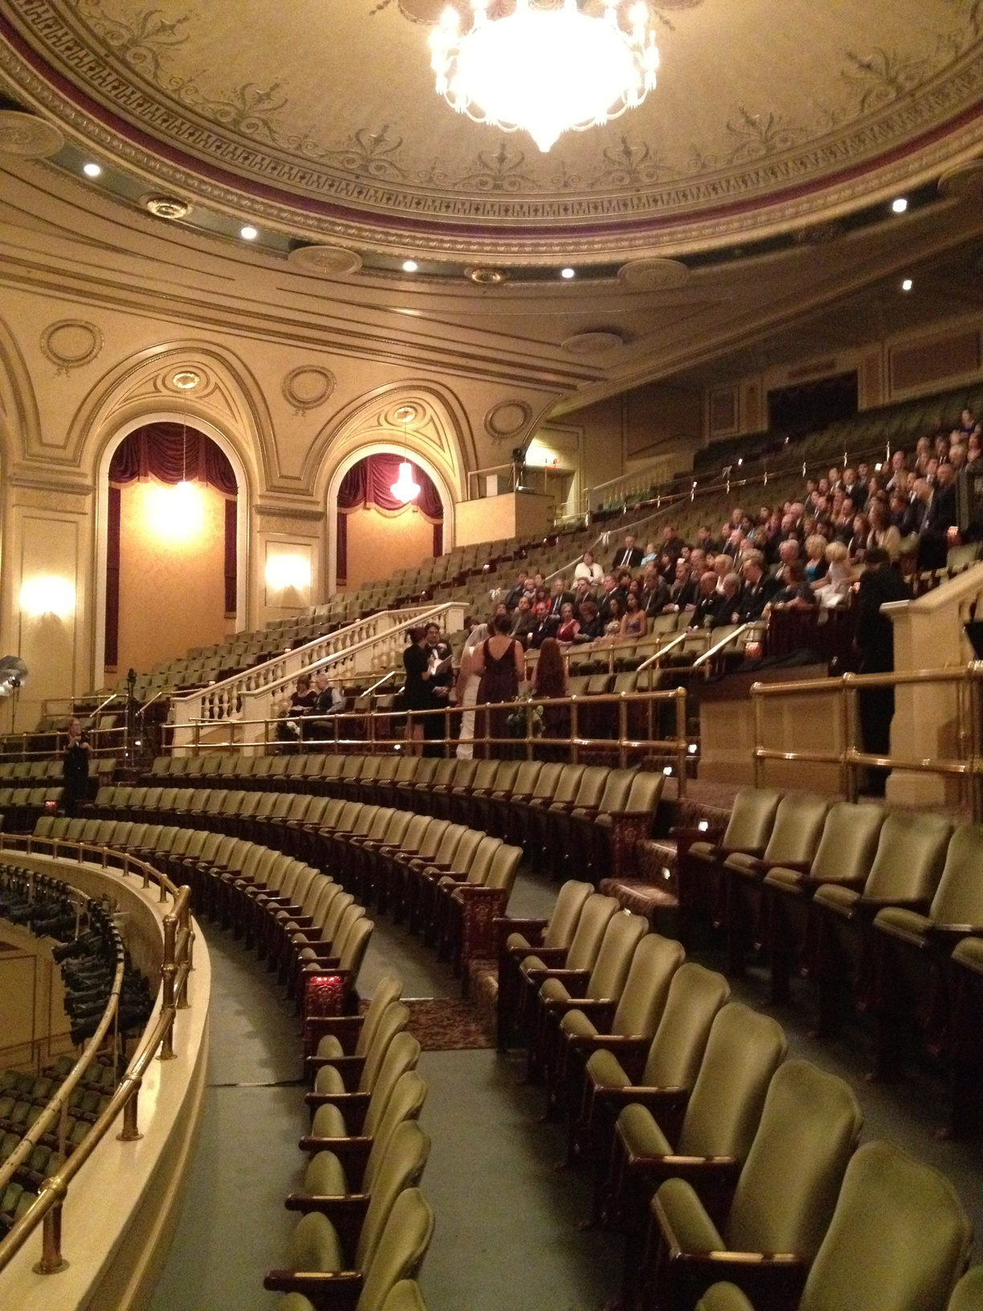
THE HANOVER THEATRE
A CHRISTMAS CAROL
Hrunay Shah
Vanshika Kahaliya
Jing Zhou
Srivalli Adigarla
Shailja Sharma
Lohith Jaganathan

Slide 2
Table of Contents
Introduction
Objective
Marketing Strategies
Conclusions

Slide 3
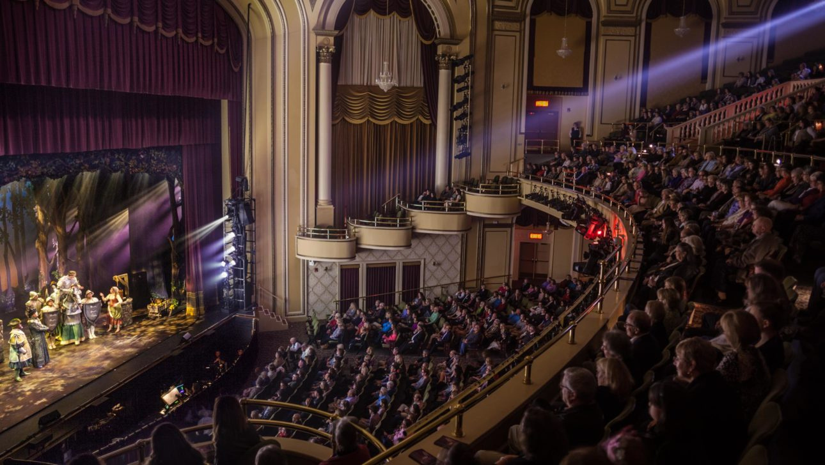
Introduction
Hanover Theatre is a historic performing arts venue that captivates audiences with diverse live performances.

Slide 4
Our goal is to boost ticket sales for Hanover Theatre’s Christmas Carol. Through strategic collaborations and re-engaging inactive customers, our data-backed strategies aim to elevate sales and enhance community visibility.
Objective

Slide 5
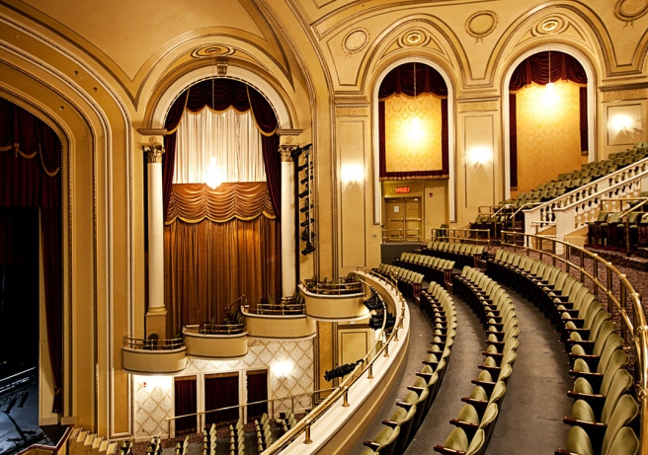
Marketing
Strategies

Slide 6


In Unity, We Fly

Slide 7
In Unity, We Fly
Simple Shipping, Powerful Results
Youthful Impact

Slide 8
In Unity, We Fly
Simple Shipping, Powerful Results
By incorporating our posters or pamphlets into UPS deliveries, tap into a vast and diverse audience, ensuring strategic visibility and timing. This innovative partnership enhances your event's reach and impact

Slide 9
In Unity, We Fly
Youthful Impact
Empowering youth through collaborative initiatives with theater schools and student volunteers not only enriches their personal development but also cultivates a positive influence, fostering a vibrant community atmosphere with lasting social impact.

Slide 10
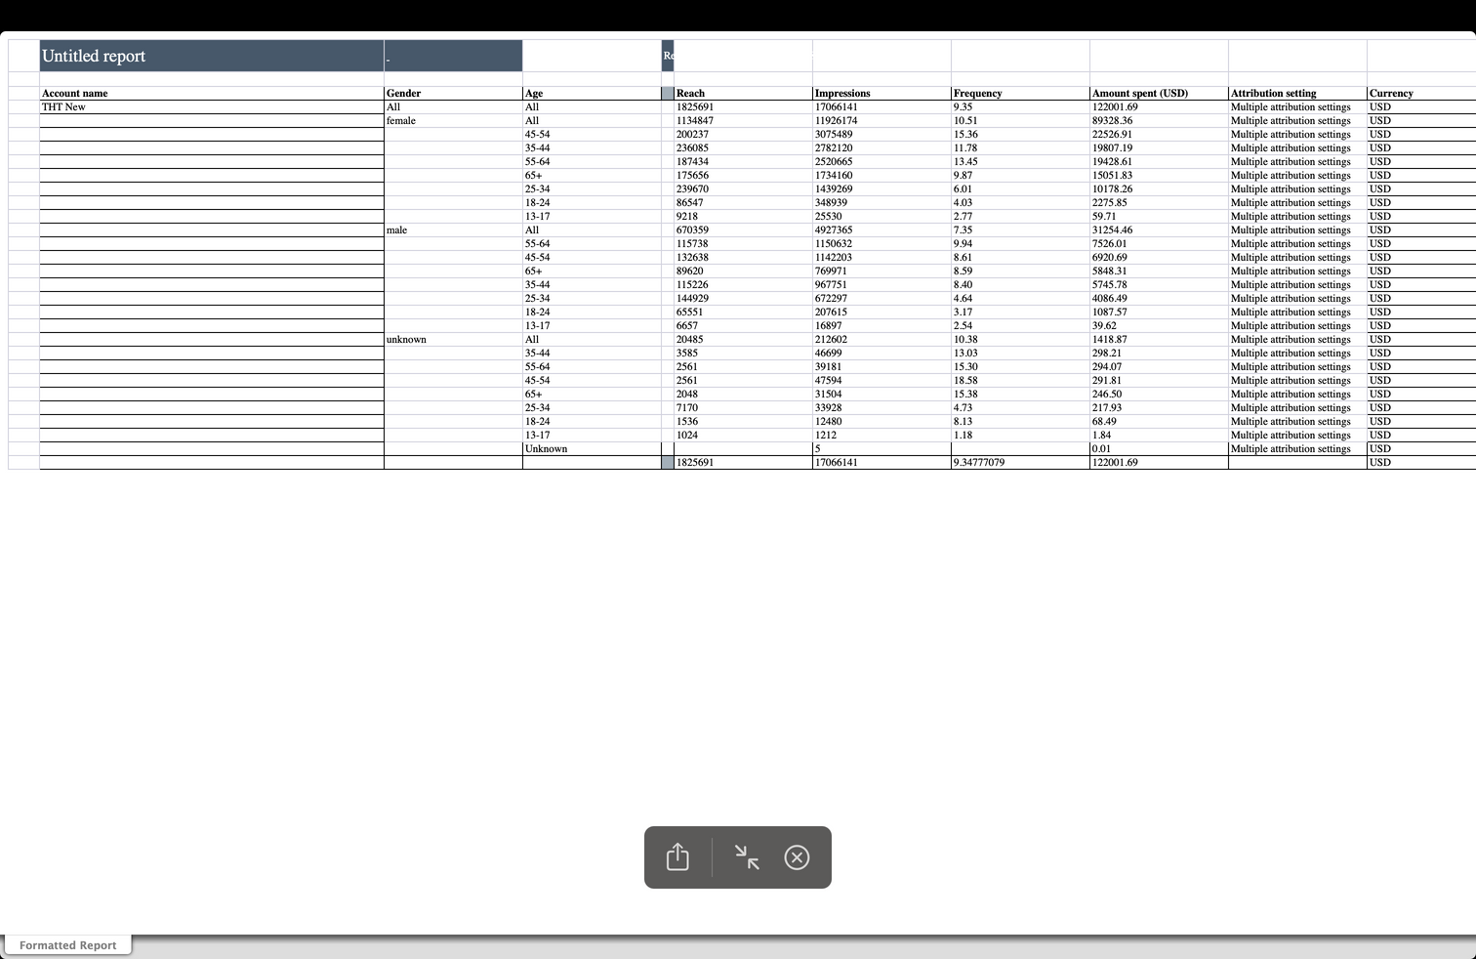
Supporting
Data

Slide 11
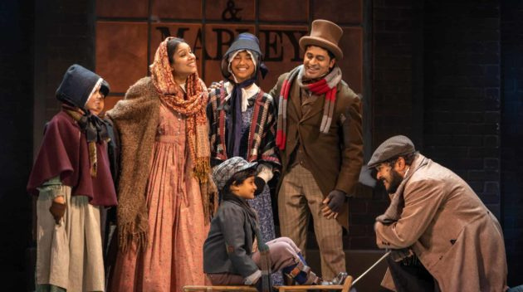
Benefits
Vibrant Community Atmosphere
Increased Attendance Through Motivational Ripple Effect
Broad Audience Reach
Increased Ticket Sales Through Impactful Collaboration with UPS

Slide 12
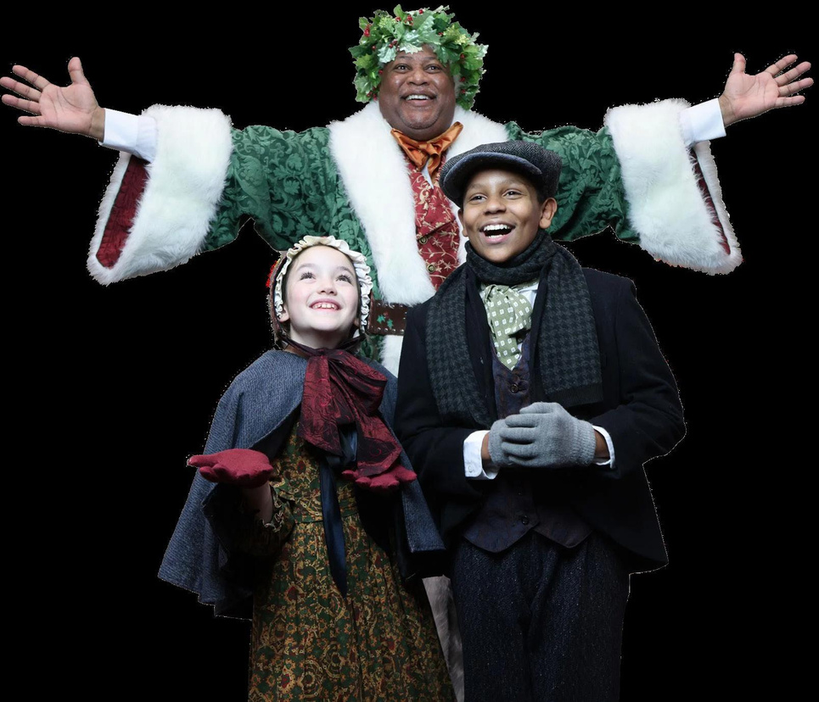
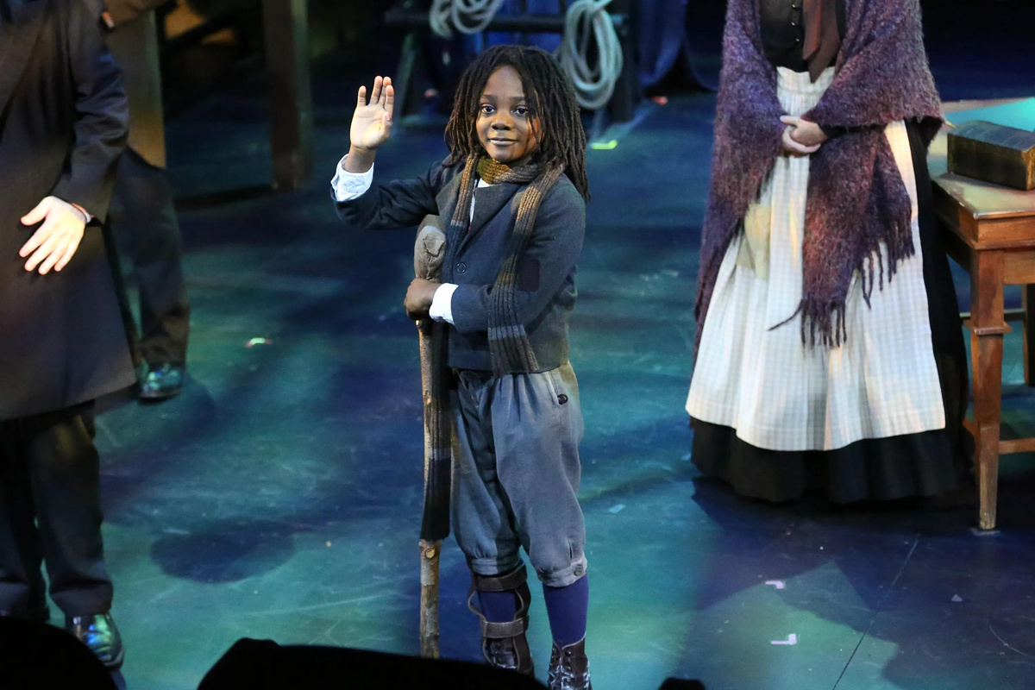
Re-engaging Stale and Lapsed Attendees

Slide 13
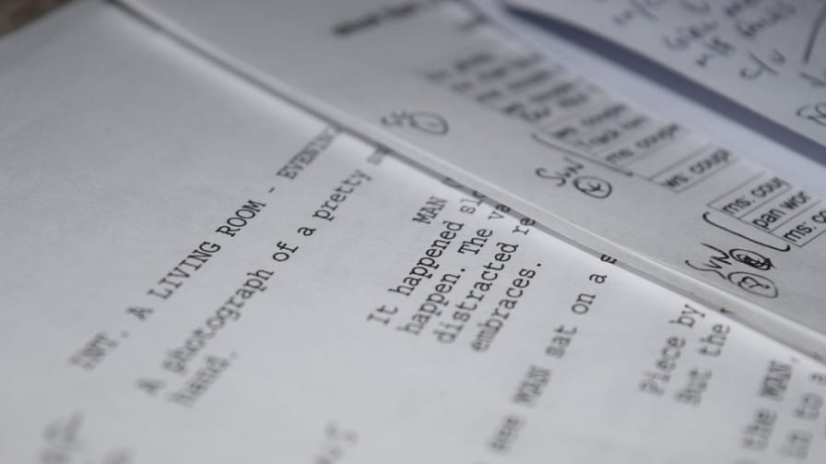
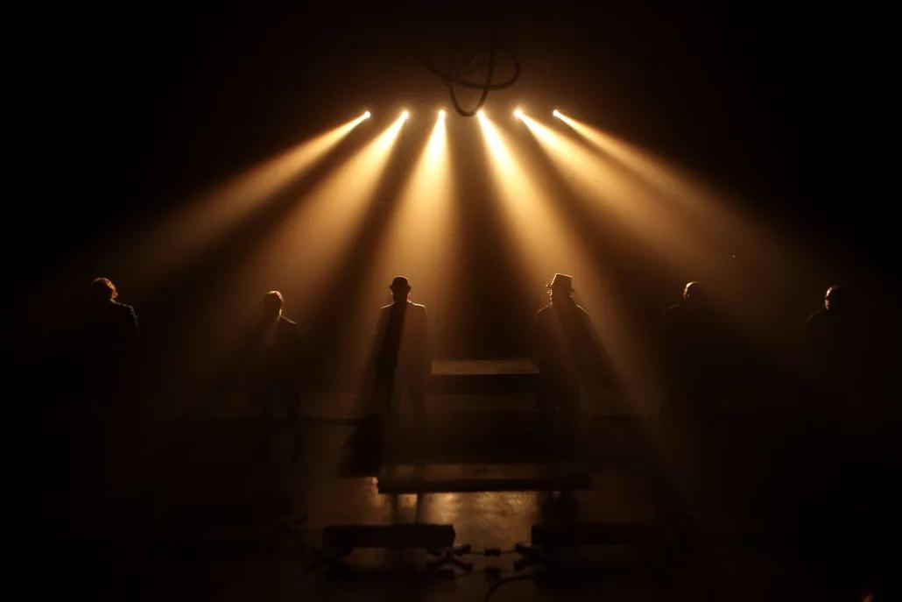
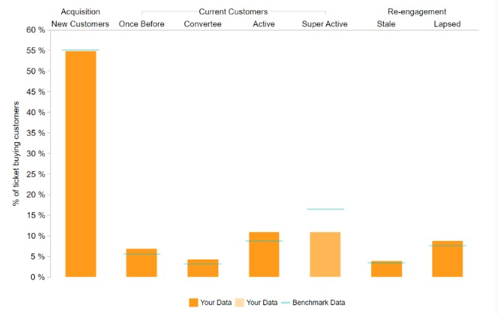
Re-engaging Stale and Lapsed Attendees

Slide 14
Email Marketing
1) Targeted email campaigns towards Stale attendees (18-36 months) and lapsed attendees (3+ years) for re-engagement.
2) Your Exclusive 10% Discount for "A Christmas Carol" is Here! 🎁
Use Code: JINGLEJOY10
3) Personalized emails expressing appreciation.
4) Highlight excitement about upcoming shows.

Slide 15
CITY - FOCUSED MARKETING

Slide 16
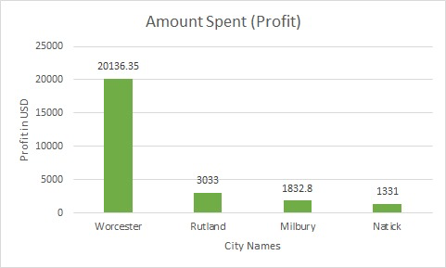
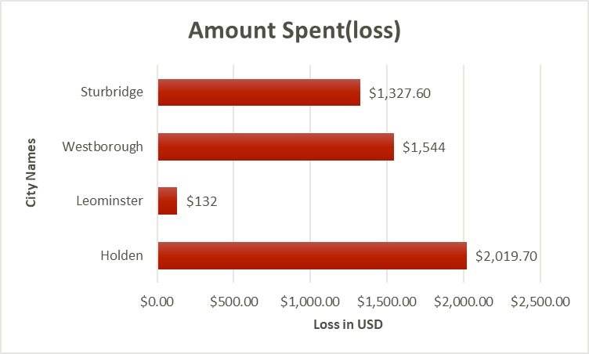
CITY-FOCUSED MARKETING

Slide 17
Recommendations
1. Strategic Focus: Channel resources and efforts towards cities with positive revenue
growth.
2. Adaptation of Successful Strategies: Replicate successful strategies from high-growth cities
in areas with growth potential to benefit sales for a Christmas Carol.
3. Continuous Monitoring: Implement a robust system for regular revenue trend monitoring

Slide 18
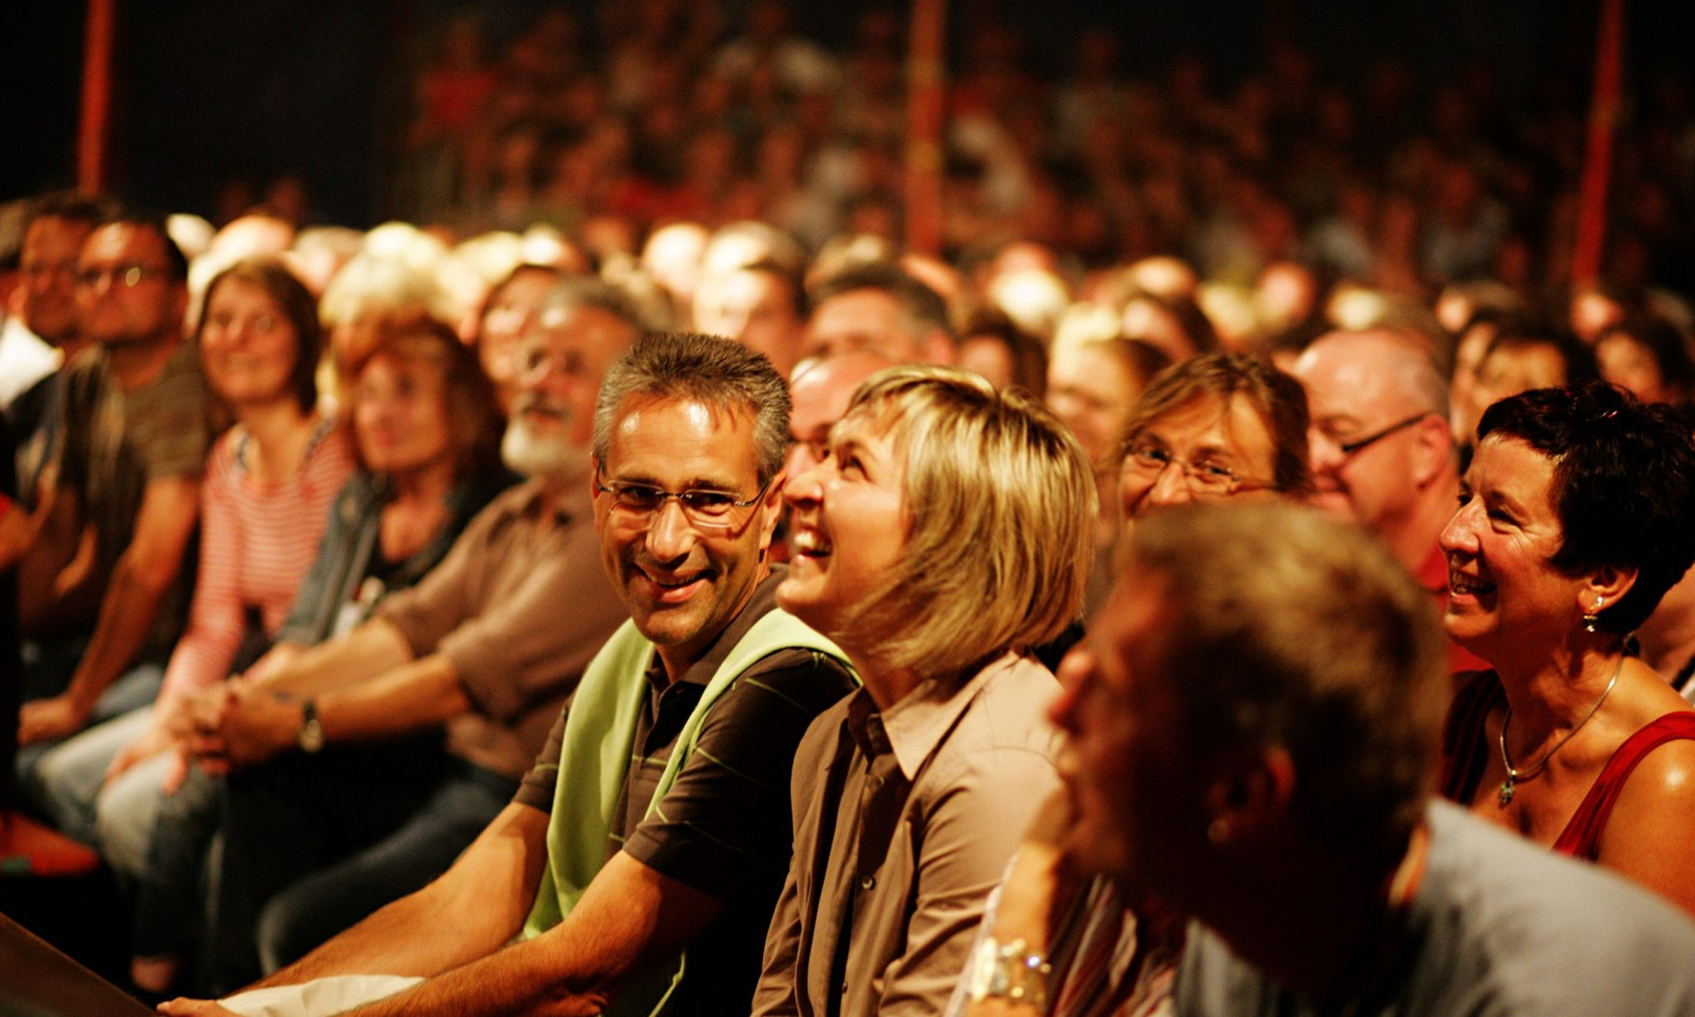
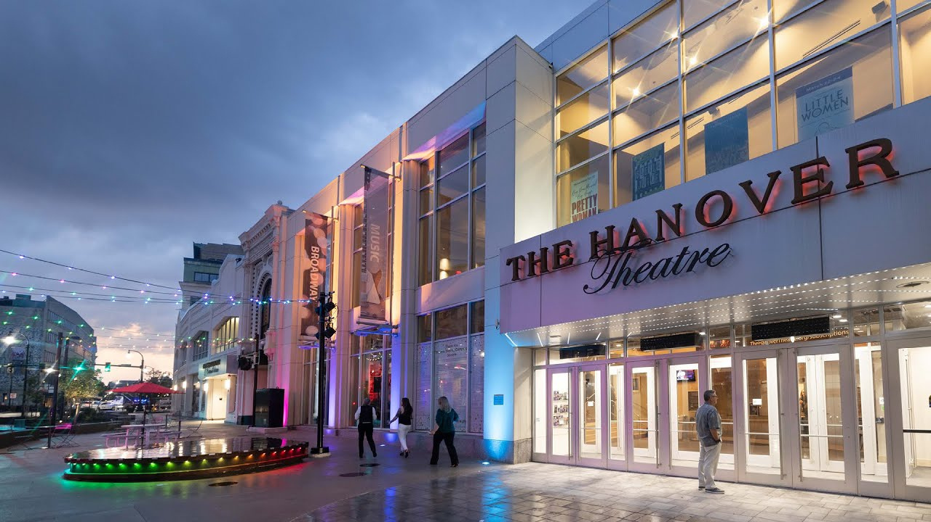
Femme Focus

Slide 19
Femme Focus
To maximize outreach and engagement, we aim to target females, the predominant user demographic, by offering exclusive group package giveaways for
"A Christmas Carol."

Slide 20
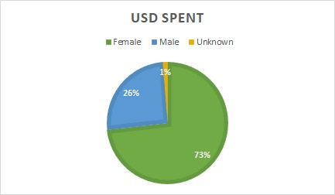
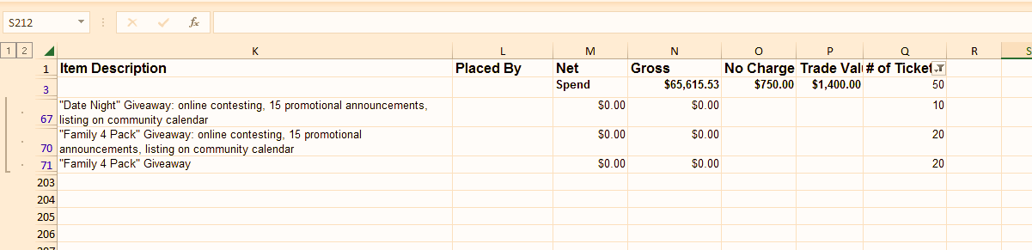

Slide 21
Recommendations
Collaborate with Women’s Groups:Partner with women's organizations, clubs, or online communities to extend the reach and impact of your giveaway.
Customized Group Packages:Consider offering customized group packages that include additional perks, creating a more enticing giveaway.
Encourage Group Participation:Structure the giveaway to encourage women to participate in groups, promoting shared experiences and strengthening bonds.

Slide 22
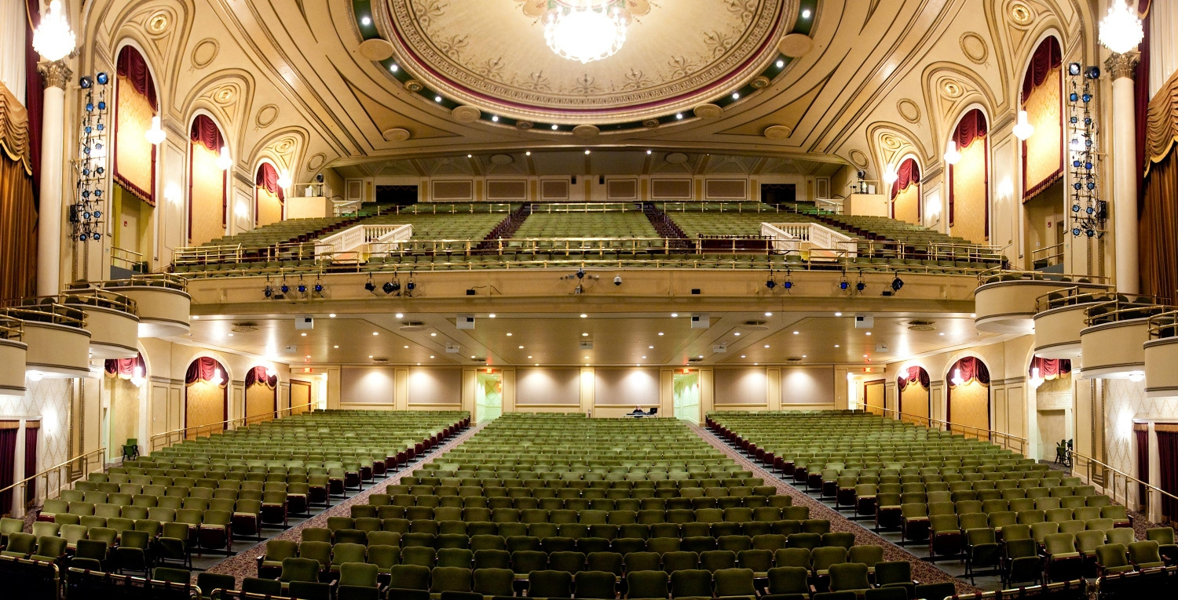
CONCLUSION
The path to increased ticket sales for the Hanover lies in the implementation of the recommended solutions.
A key strategy is to cultivate and prioritize audience loyalty, establishing a devoted base of repeat customers year after year. By fostering strong connections with our audience, we not only ensure consistent ticket sales but also create a community that actively engages with and supports the Hanover.
This commitment to building lasting relationships will not only elevate our sales figures but also solidify Hanover's position as a cultural hub that resonates with its audience.

